Slide 1
AI/data science in mining industry
By Winnie Wetthasinghe
13/04/2021

Slide 2

Mining industry in Australia
Investing in data science in the mining sector (From minister.industry.gov.au)
27 August 2019
The Government is funding the development of data science skills for the mining industry to help keep Australia a global leader in the mining sector.
Minister for Education said the Government was investing $7.67 million to fund two mining research centres in partnership with universities and commercial supporters.

Slide 3
Mining industry in Australia cont’d.
Minister for Resources and Northern Australia said the funding would help keep Australia’s resources sector at the top of its research game.
"We are blessed with abundant, high quality resources such as coal, iron ore and gas which return billions to our economy each year. Demand for the minerals that drive modern technologies, like lithium, rare earths, nickel and cobalt, is also surging.
There is a big amount of available data from the mining industry that data scientists can use to improve and develop new technologies for this industry.

Slide 4
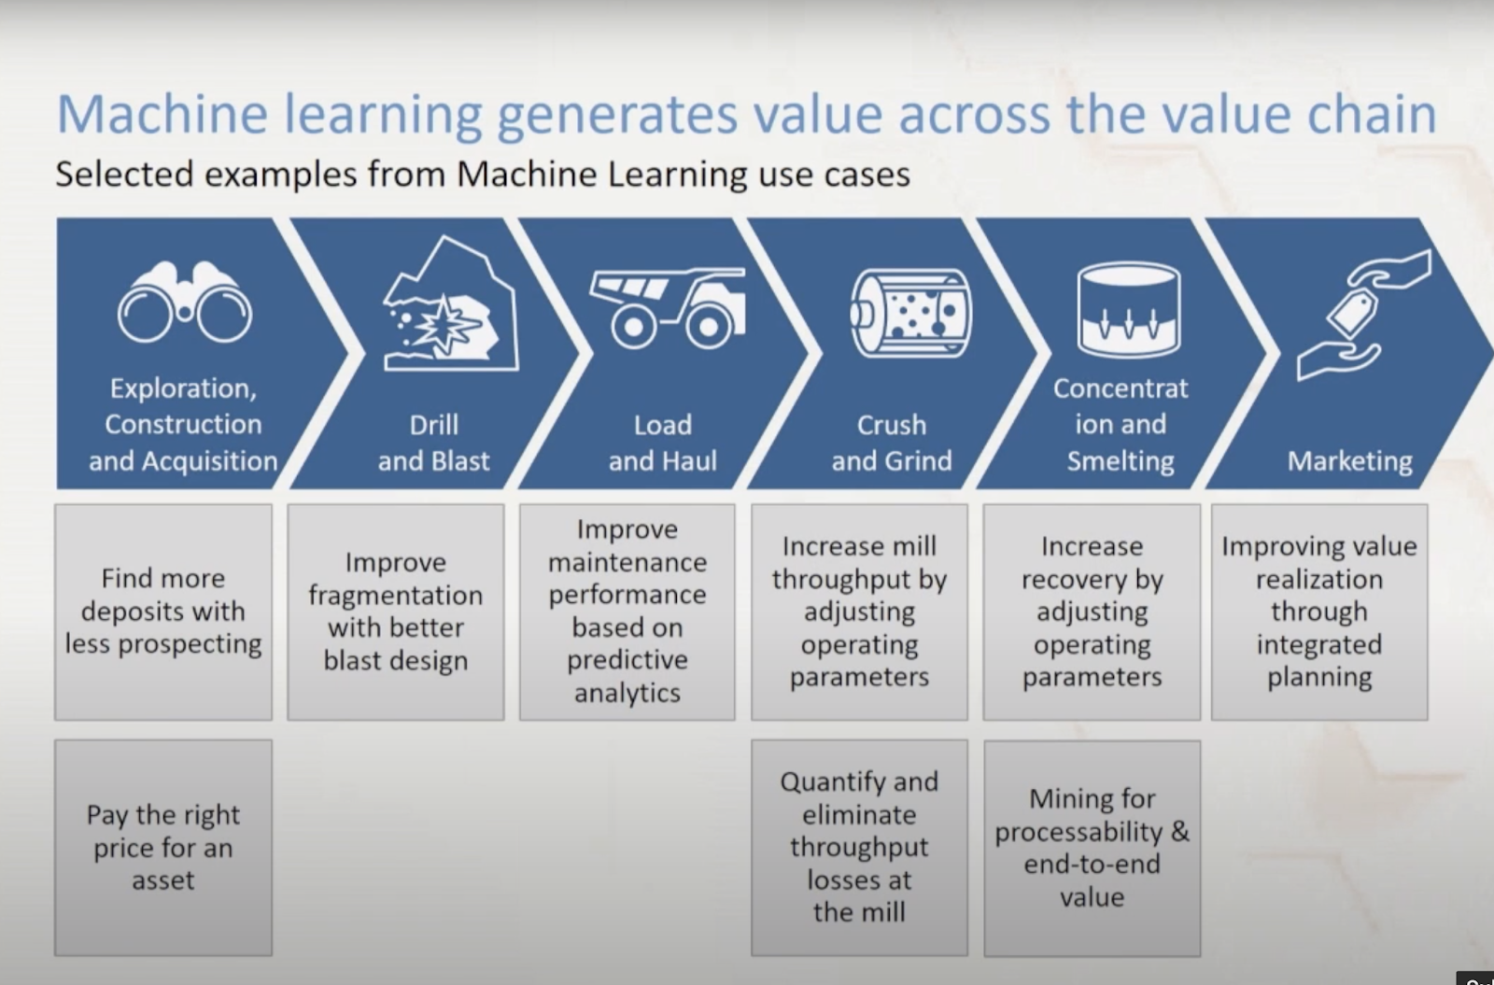

Slide 5
Use case 1
Use case-Recovery Improvement.
There can be a significant increase in minerals and ores that can be recovered through data science. More companies try to increase the amount of minerals they get/recovering from the ore, depending on the type of mineral.
The more you can extract the better. Anything that you don't recover (gold) is going to go waste.
So, need to put as much effort as we can as long as it's still efficient to do so. DS can increase the recovery percentage with minimal effort by just analysing data.

Slide 6
Use case 2
Predictive Maintenance and Loss Prevention. Mining operations require a lot of equipment (e.g., trucks and mills) which are very expensive to maintain. Through sensors of temperature, speed, or vibrations, we decrease the number of losses.

Slide 7
Use case 3
Autonomous Transportation. There’s a lot of moving around done during mining operations. Some companies are looking into developing self-driving heavy-duty mobiles for a more accurate and faster move.

Slide 8
Use case 4
Mineral Exploration. It’s easier to find the area with largest deposits through the use of machine learning. In this way, we also do the process efficiently.

Slide 9

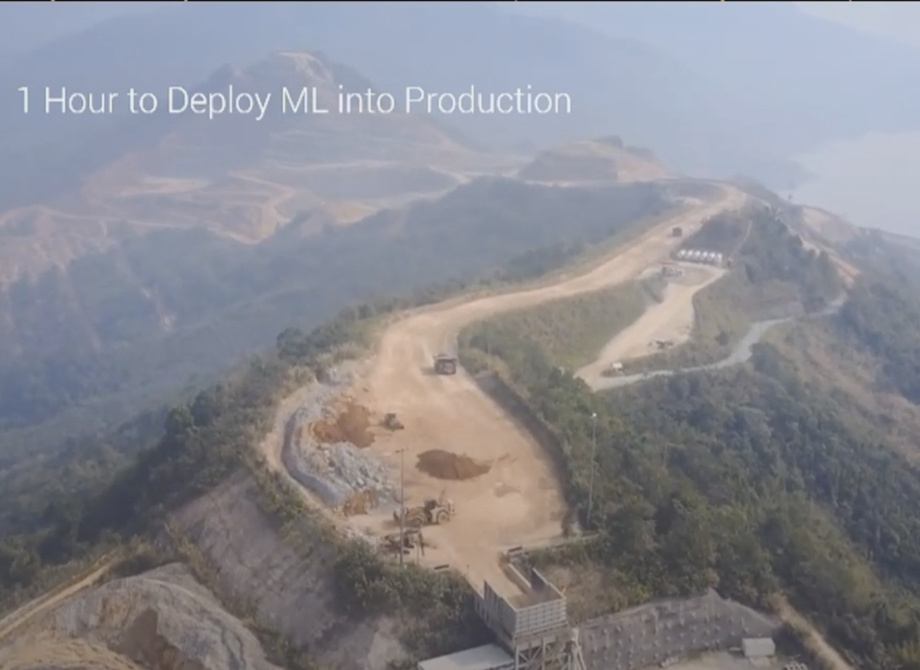

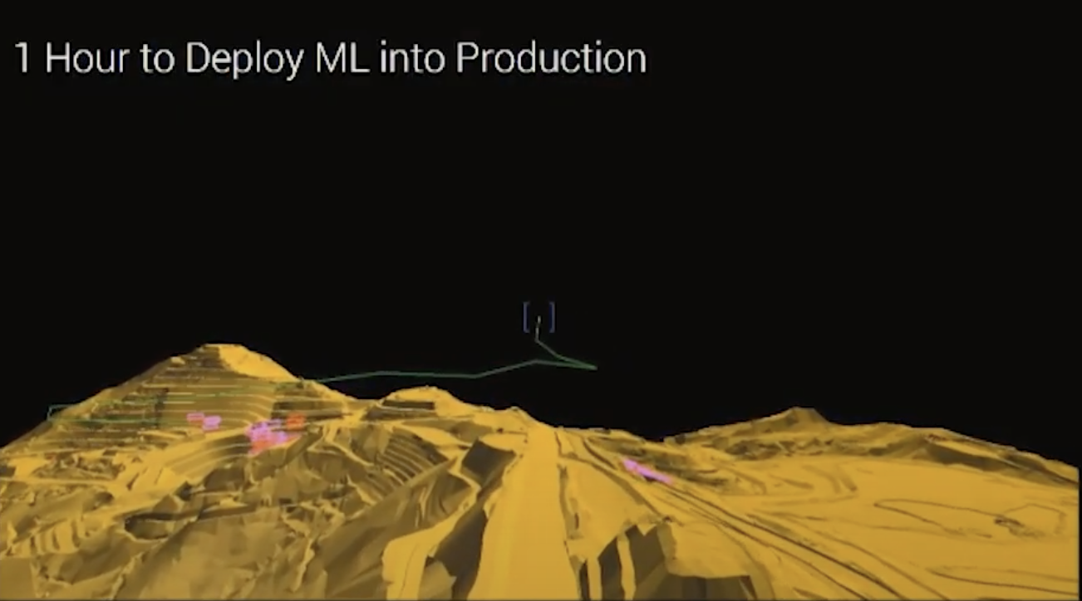
Mineral exploration through digital twin optimization
Lastest case study from Benos imine in Laos
Digital twin value chain optimization
Find hightailing grade blocks which they are the blocks that are sending lot of precious metals out of the tailings dam (To find where the ore is).

Slide 10
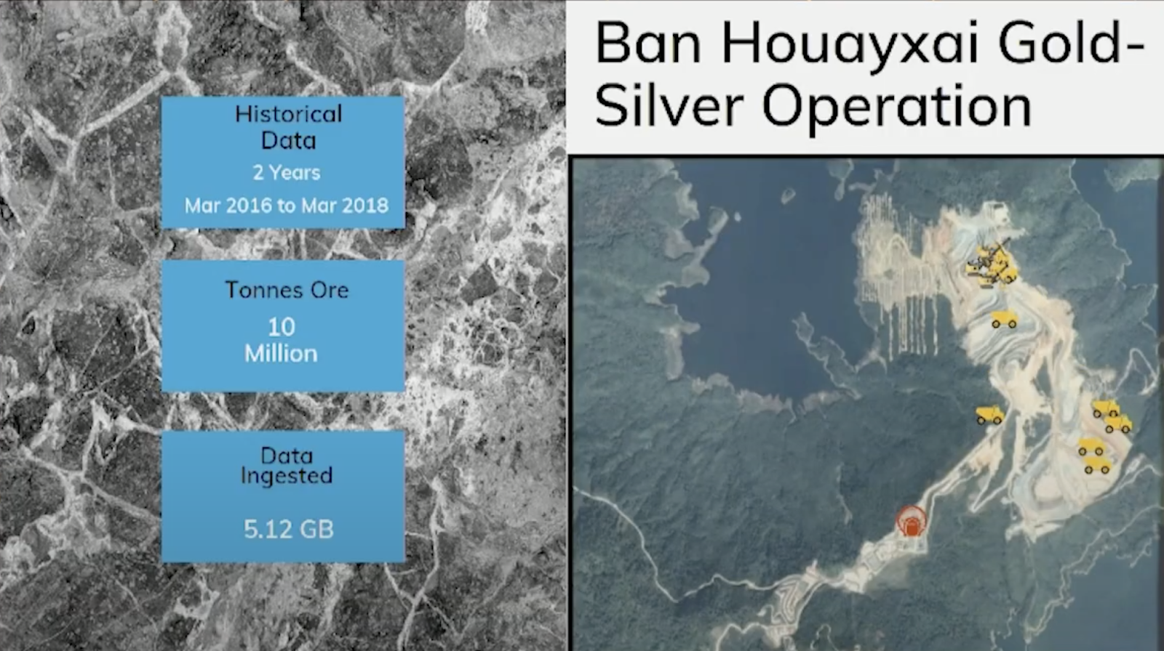
Spatial data and time-series
Once you take spatial data and convert it into a time-series, it enables you to do machine learning algorithms.
To build the model typically use 1 year or 2 years of data include, geology, drilling blast, include weather, and other factors that might impact on the process. This is small mine 5.12 GB sometimes, couple hundred GB. Geology, blasting, loading haul, liberation, separation, got metal. Maximise metal produce at the quality specification that needing to sell it up.

Slide 11
Use case 5
Workers’ Health and Safety. If you want to be valuable in this industry, this is the top thing you should be concentrating on improving. 12000 people die every year due to mining accidents. Through data science, we can improve the situation and help save peoples’ lives.

Slide 12
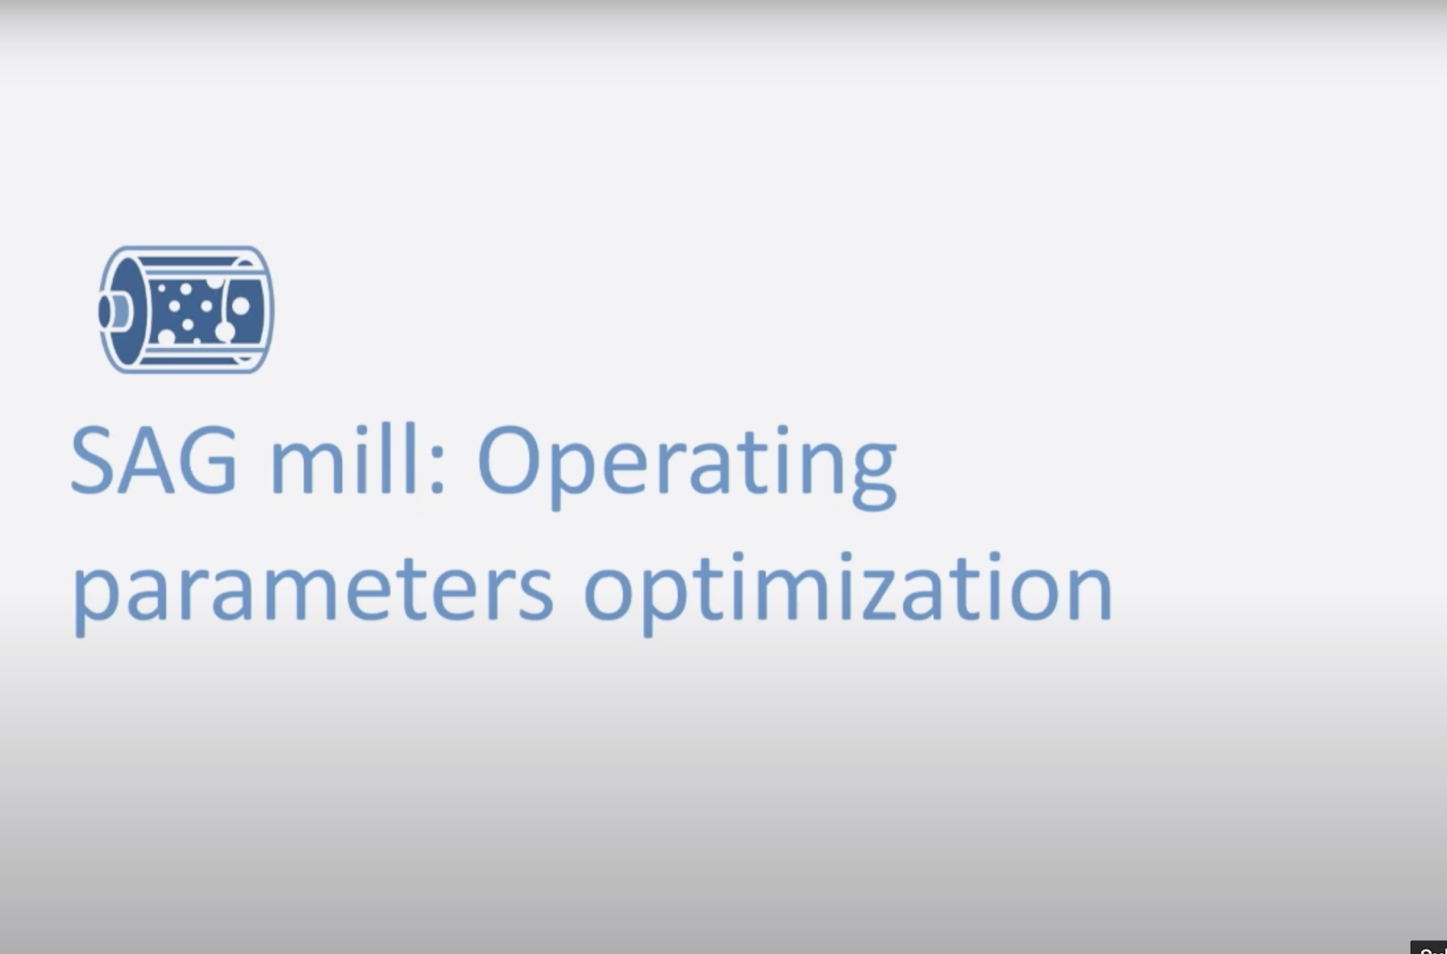

Slide 13
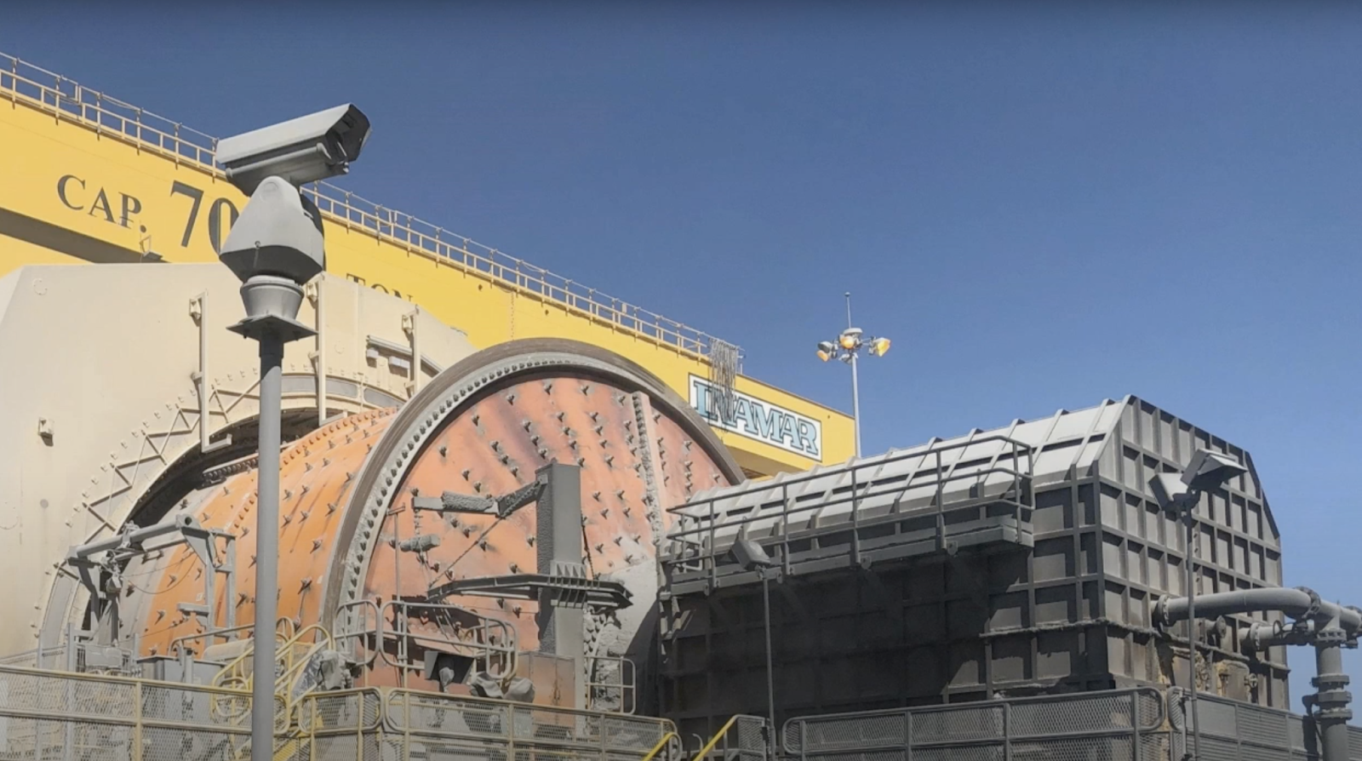
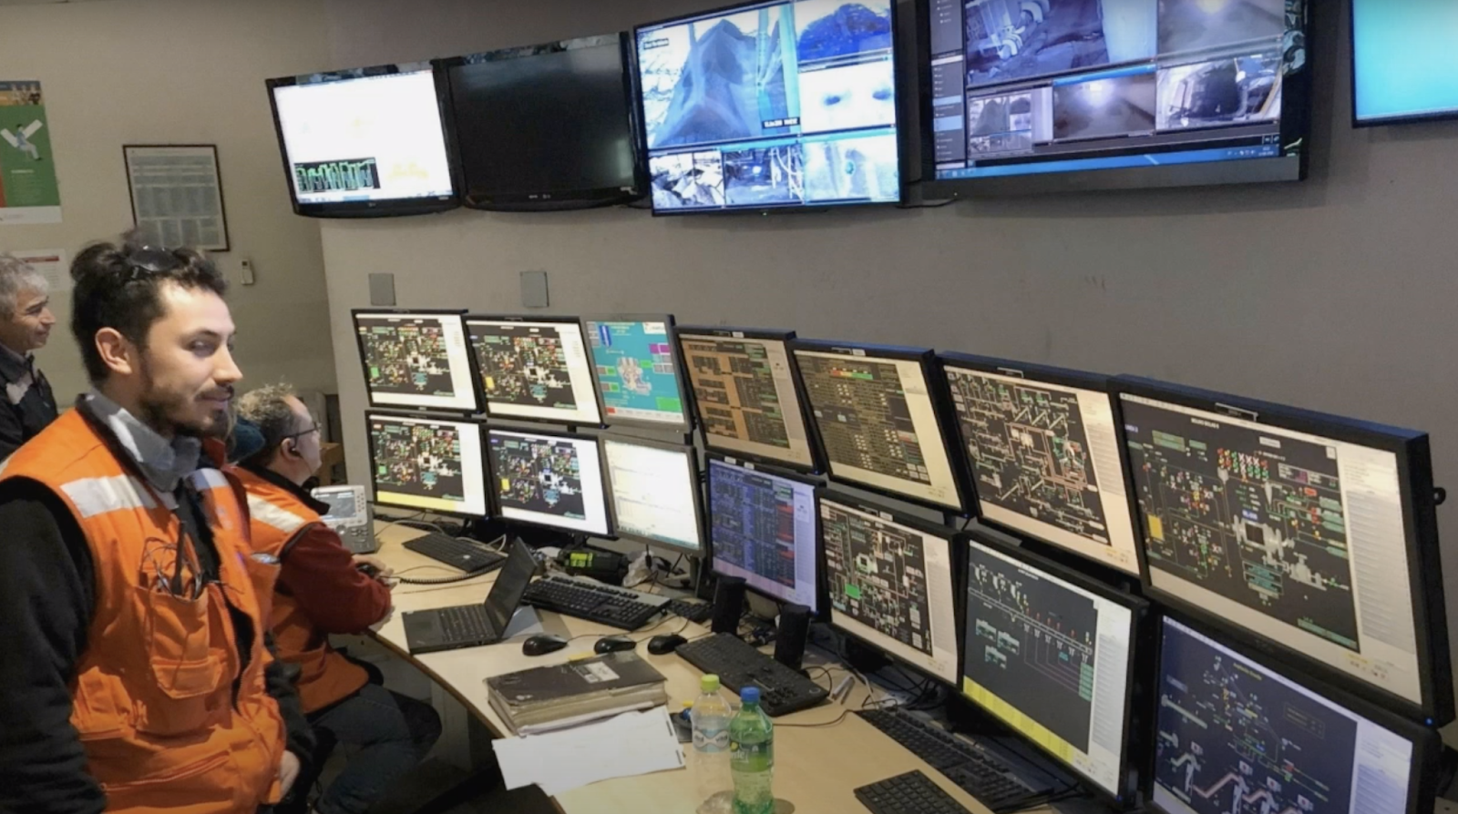
Copper mining SAG mill in Chile.
Although most operations are mechanical pretty much controlled with a lot of technologies and control systems that will provide inputs and certain ranges for the optimal parameters until they give the best throughput

Slide 14
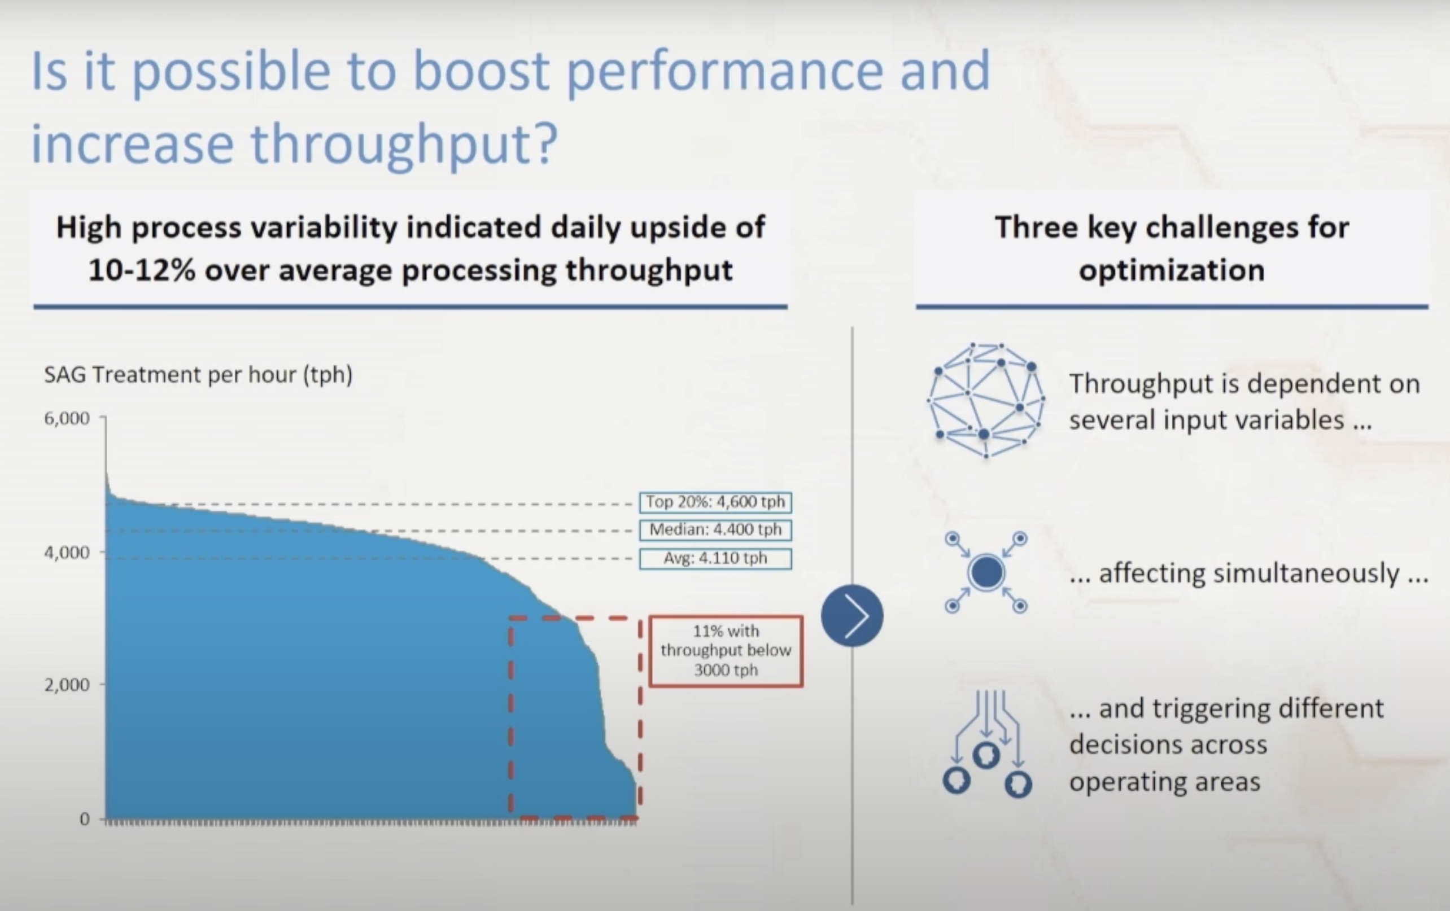
The treatment per hour changes significantly. Not very stable. Many times, it’s unknown why it has going down. Could be harder process or blasting with an explosive product that is not as powerful. So, we are getting lower fragmentation.
Decision making-different areas, more blasting, favour to the SAG people
Different mine operations, speed, load and process etc.

Slide 15
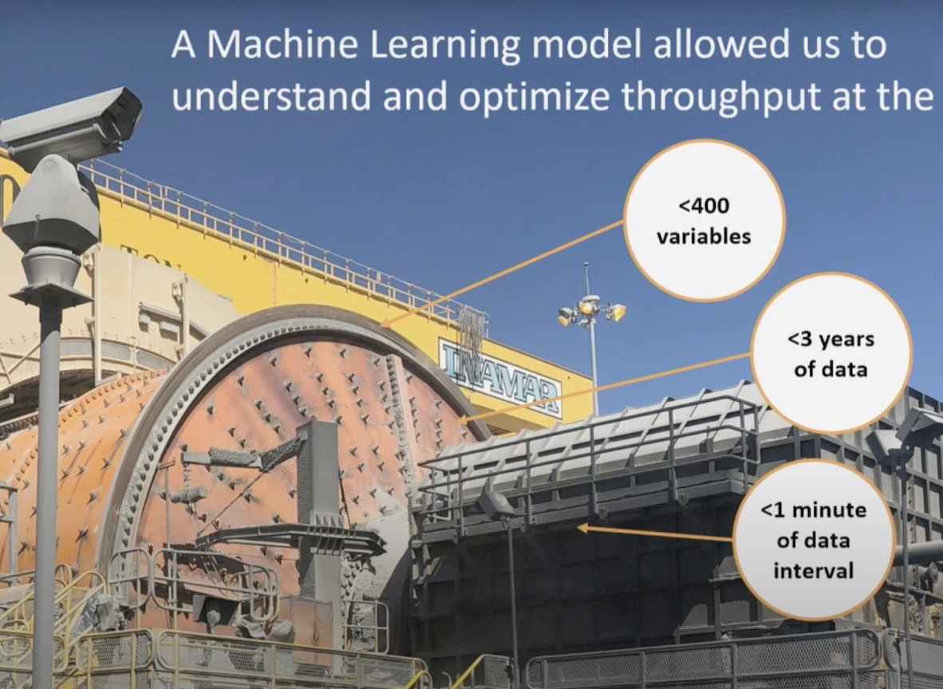
Using a machine learning model. They identify and lift over 400 of variables, and 3 years of data. Data points available with 1 minute interval. They will give you way over 500 million data points.

Slide 16
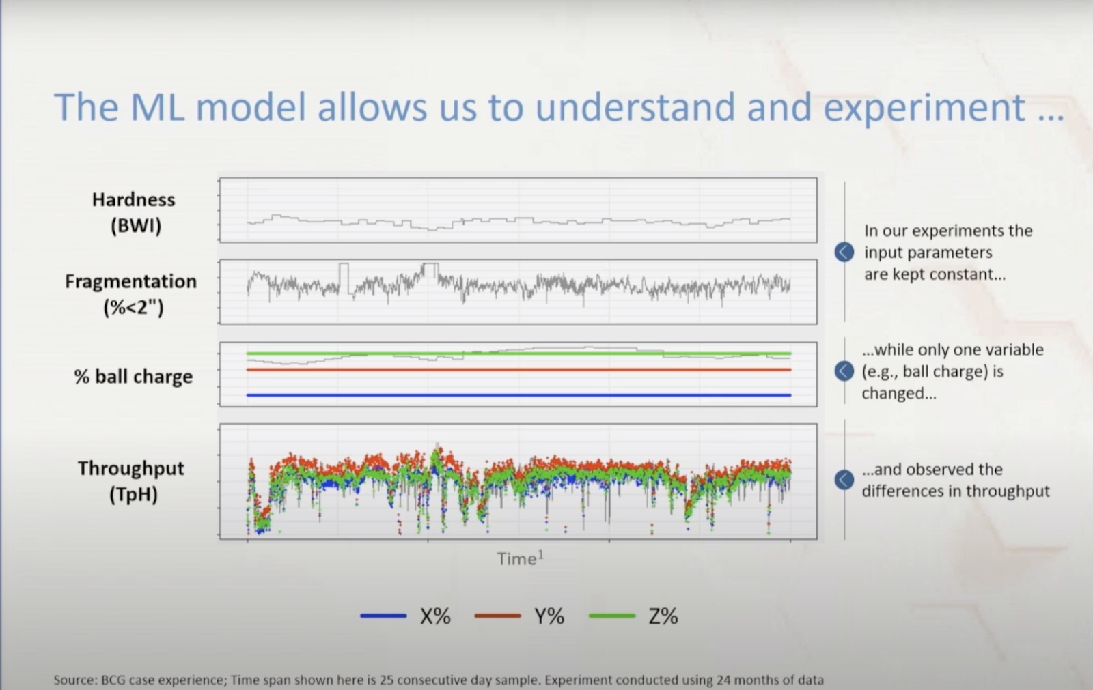
Hardness and fragmentation using actual data. Control one variable. Controlling ball charge.
Check the percentage of balls and grinding media we put into system.
Throughput with 3 different levels. Representing by green, red and blue.

Slide 17
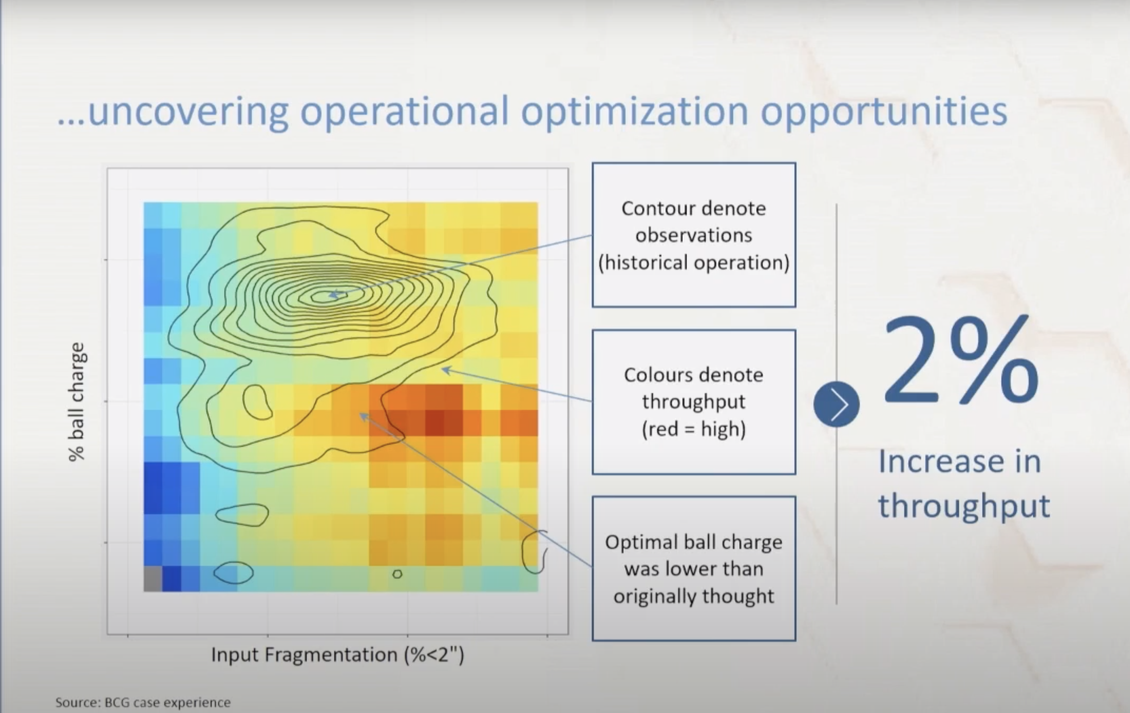
Insight starts to happen
A graph of ball charge vs input fragmentation (input from the mine). Colours mark the level of throughput. More red, is more throughput. Blue is lower throughput.
Higher fragmentation moves into a higher throughput of the side. Contour shows the historical levels of at which they observe these 3 years, where they are operating.
The ball charge it appears the optimal level is quite lower-22% ball charge to 19% ball charge. Increase input in not huge but it's significant when we are talking about the bottle neck.

Slide 18
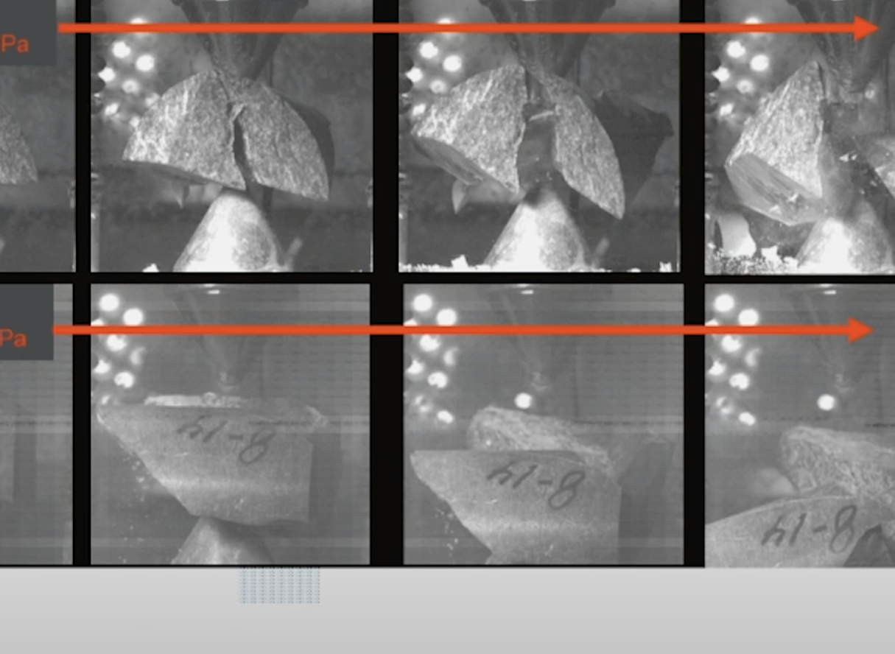
Drilling and Blasting
Geology helps to understand the issues why we don't get the results we expect.
Two rocks from the same mine, 5m apart UCS how they measure strength in rock mechanics.
Same rock type fracture for four different ways. This is why we need to integrate digital twin-drilling blasting optimised to different rock types.

